Slide 1
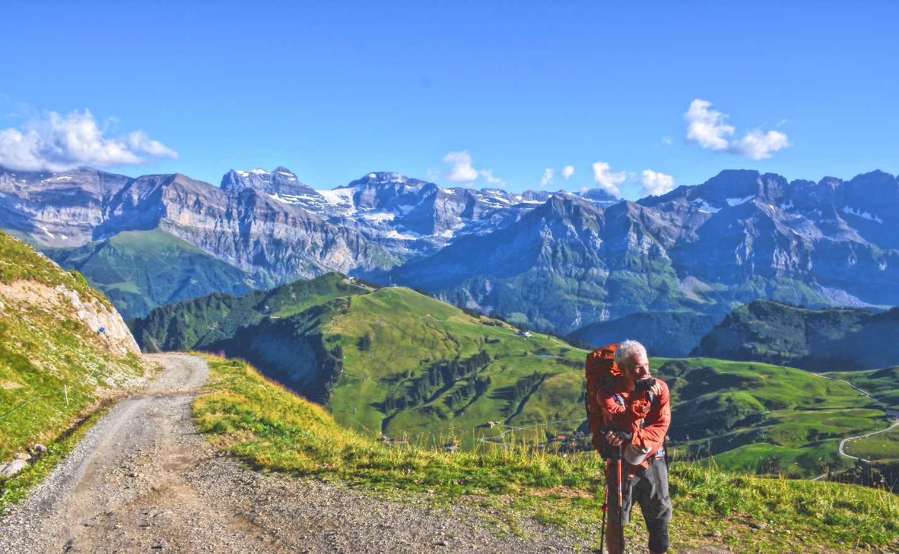
Take A Hike
The scenic route to life: A fast way to plan, implement and record your hiking adventures

Slide 2
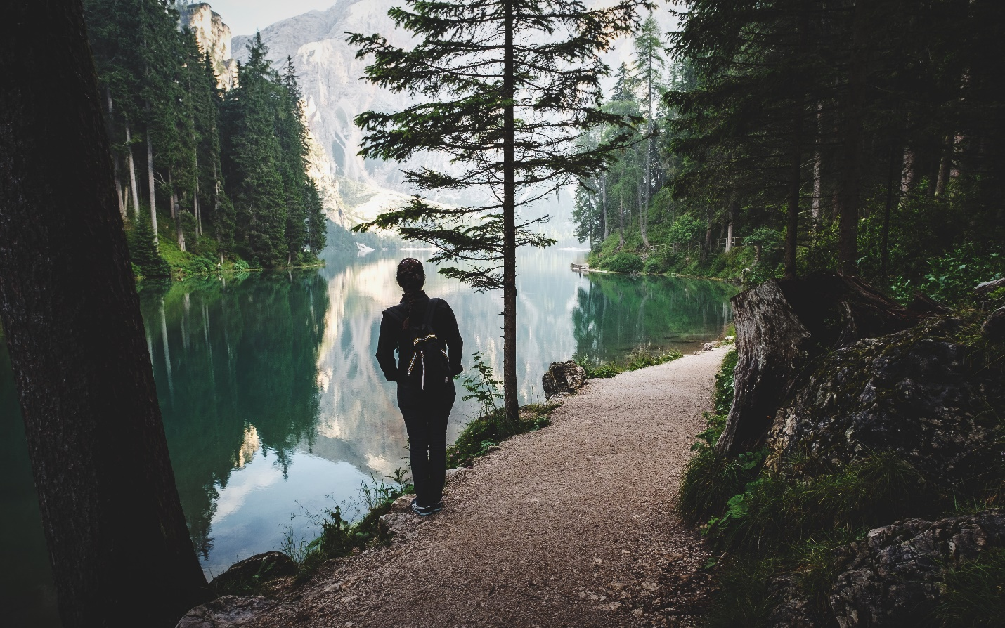
Why we chose hiking?
There is no better way to enjoy nature than to hike trails. To fully appreciate your surroundings, you must take it in slowly. The sights, the sounds and the smells of nature cannot be absorbed in an air-conditioned car traveling 80 miles an hour. You must fully engage your senses to your surroundings to get the peace and tranquility that only a hike can give. To decompress from life, you must slow down and spend time in nature. And we can make it easier with our “Take A Hike” app to help you plan and record your experiences. Walk through the interesting paths of life. See the sights that are not available on any road. And take a hike!

Slide 3
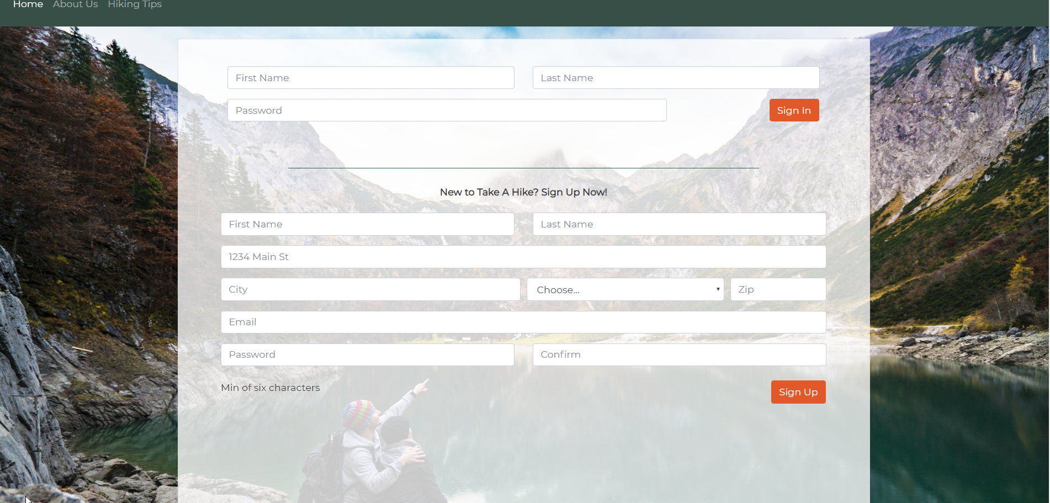
Sign in first time with name, address, email and password. This makes a cookie for reusing program.

Slide 4
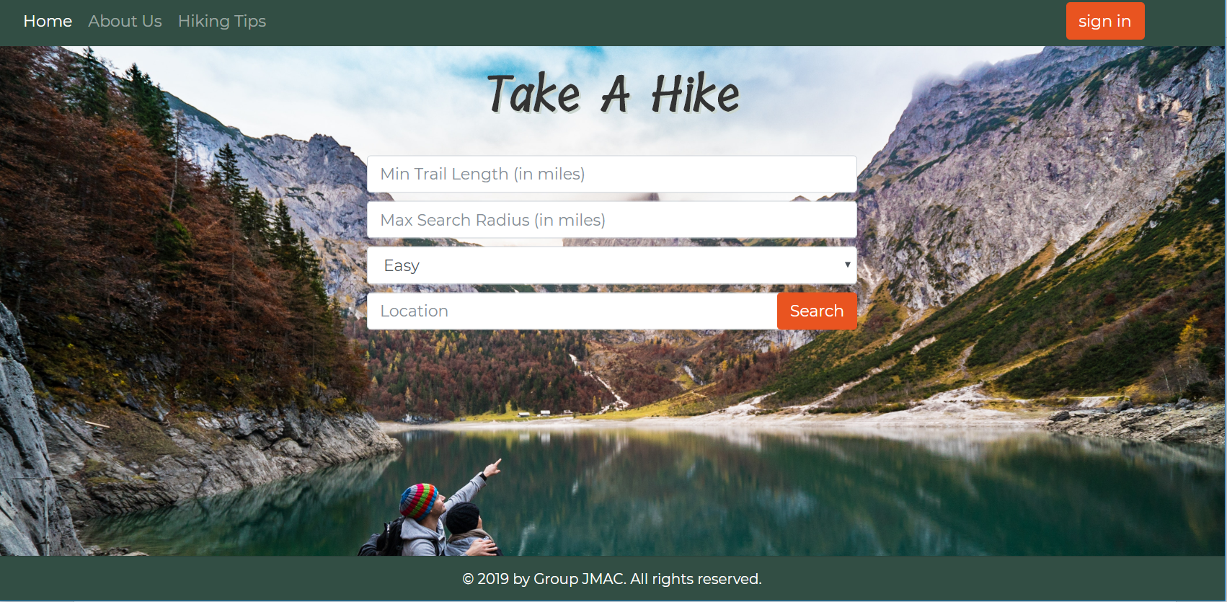
Second page with sign in and parameters for the hike

Slide 5

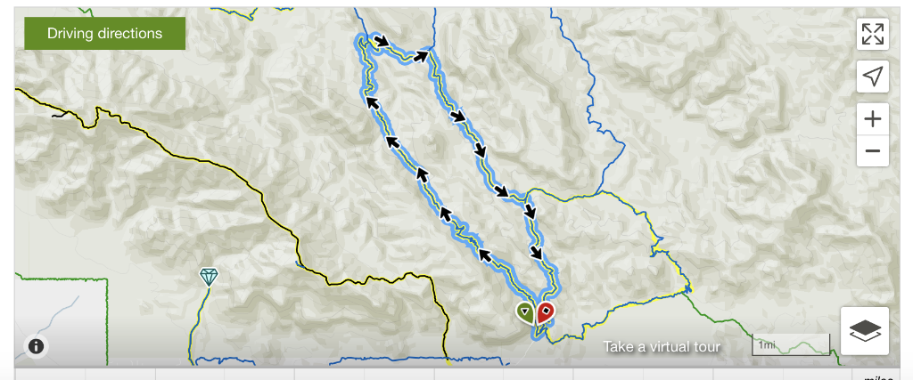
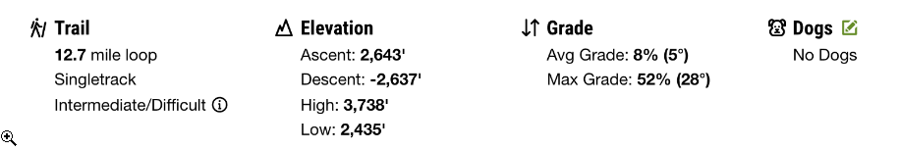
Features:

Slide 6
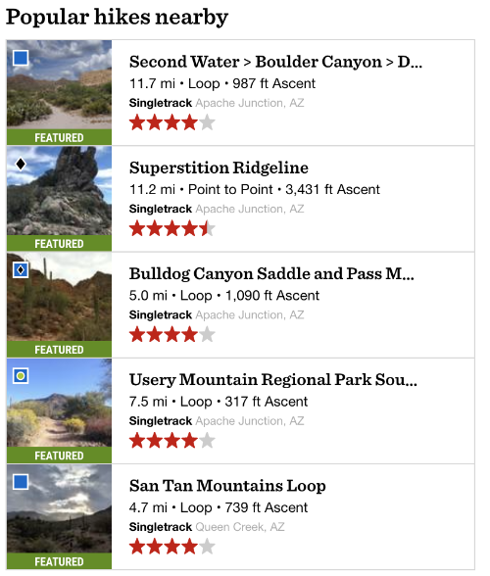
Key Hiking difficulty level
Blue box
Black
Diamond
Blue Square
Black Diamond
Blue square green circle
Blue square
Intermediate hike
Extremely Hard
Medium Hard
Medium Easy
Intermediate

Slide 7
Project parameters needed for project
https://www.hikingproject.com/
Zipcode npm
Passport.js
Use cookies for sign in
Handlebars
https://maps.googleapis.com/maps/api/geocode/json?latlng google maps supply latitude and longitude coordinates.

Slide 8
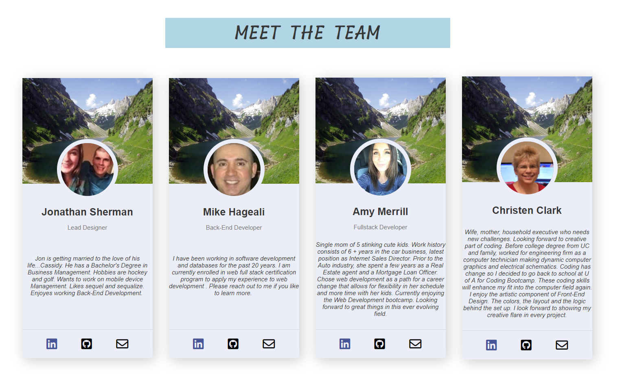

Slide 9
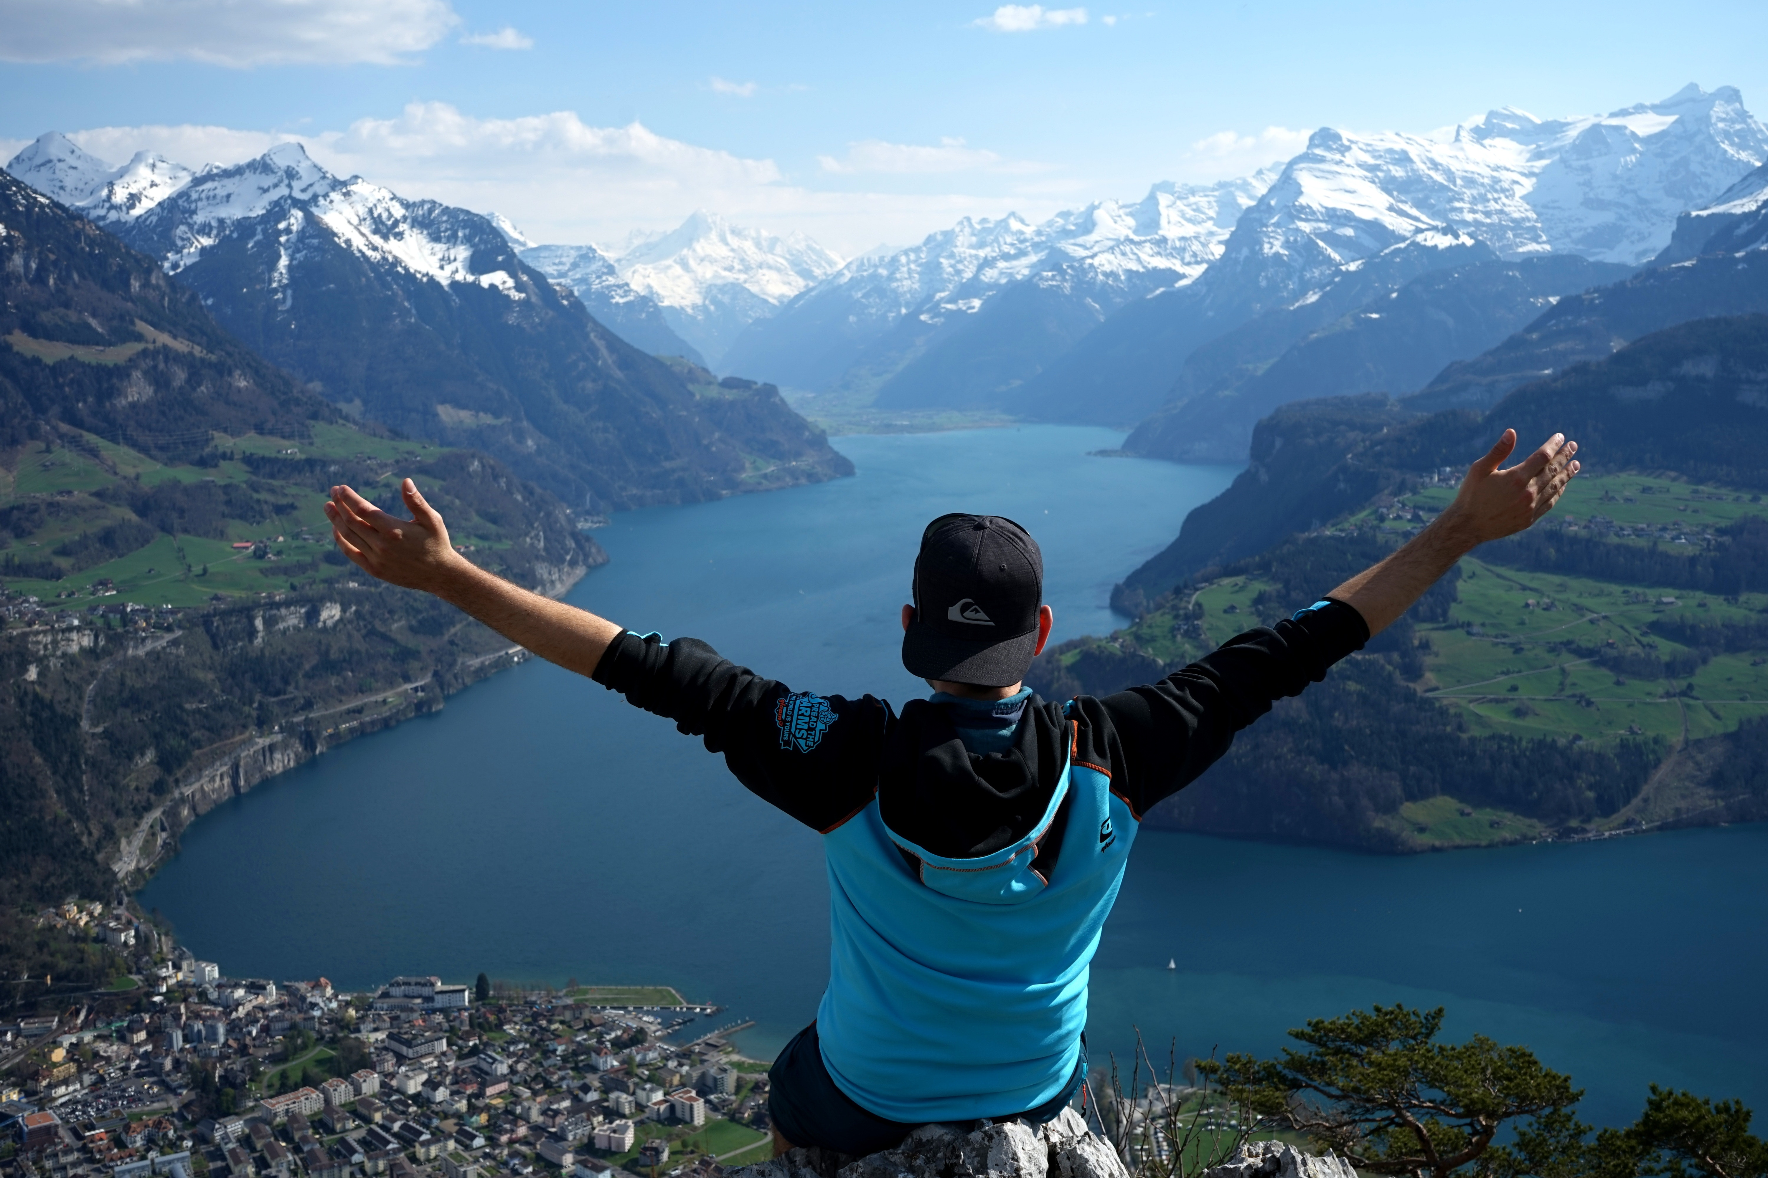
Thank You

